Slide 1


Bank of Baroda Hackathon - 2022
Technology Partner
Your Team Name :Hack Packers
Your team bio :Dinesh V C
Harish C Kiruthiga S Vidhyashree A K
Date :19.09.2022
////011

Slide 2
VIRTUAL
ASSISTANT
1) Customers may need assistance to complete process requirements, and occasionally they lack all the necessary information, therefore we chose a virtual assistant to boost the use of digital channels and save operating costs.
2)There are several benefits to working as a virtual assistant, including a flexible schedule, the choice of services, and endless income potential.
3)Additionally, obtaining clients on a continual basis and having the necessary desire and motivation to succeed are requirements.

Slide 3
User Segment & Pain Points
USE CASES
Account Related Queries
Balance Check
Personalized Assistance
Financial Assistance

Slide 4
Pre-Requisite
The Bank of America (BoA), one of the world’s largest banking institutions, has become the latest company to join the chat assistant bandwagon with the launch of Erica, an AI-driven virtual assistant to help its 25 million mobile clients
Bank holding company Capital One launched Eno a virtual assistant which benefitted 1,00,000 Capital One users
New York-based Ally Bank was one of the first global banks to introduce a virtual chat assistant, rolling out Ally Assist in 2015 as a part of the Ally Mobile Banking app.
A virtual chat assistant for Corporate Banking at HSBC Hong Kong, Amy can provide instant resolutions to
consumer inquiries 24x7.
These are some competitive products which are existing as a model for the solution proposed

Slide 5
Azure tools or resources
Azure applied AI Services
Azure Machine learning services
Azure Data Explorer
Azure Data Lake
Azure Data Bricks
Azure Bot Services

Slide 6
Any Supporting Functional Documents
METHODOLOGY
We have classified the methodology into four stages hierarchically
Knowledge Abstraction
Data gathering
Data manipulation
Data augmentation
Response Generation
Flow of conversation and decision trees
Underfitting and Overfitting

Slide 7
Key Differentiators & Adoption Plan
Lead Generation:
Reports have seen a rise of an average of 70% in Lead Generation by the use of Conversational AI as compared to traditional lead generation tactics
Excellent Customer Experience:
CX automation using Conversational AI has seen far-fetched outcomes in terms of customer
retention and customer loyalty
Instant query:
Customer support is a mundane, monotonous, and time-consuming part of a business. Automating it can be tremendously relieving and the team can flex their dynamism to any other part of the business
Personalization:
With Machine Learning (ML), bots can retain the buyer journey of all customers. This proves to be beneficial when a customer returns to the business. Bots can give personalized perspective to the customers as per their business and help them in decision making

Slide 8
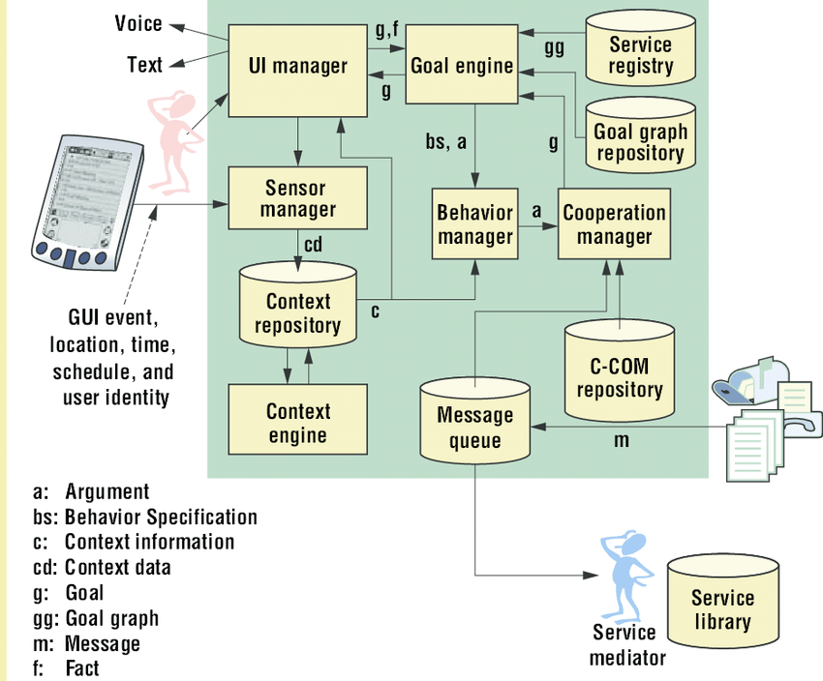
Architecture Diagrams:

Slide 9
Thank You
Team membesr names

